Slide 1
Time Series with ARIMA(Air passengers)
Aryamol k s PGDAWE01

Slide 2

Objective
Build a model to forecast the demands(passenger traffic) in Airplanes. The data is classified in date/time and the passengers travelling per month

Slide 3
Challenges in the Data
There are many missing values
Data points are in an unusable format

Slide 4
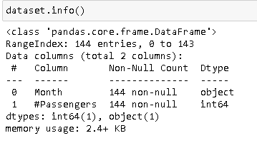

about the Data set

Slide 5
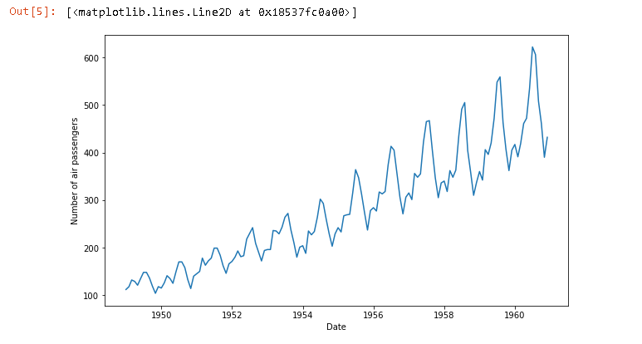
Major Findings through EDA
Time series is not STATIONARY
“Trend” component present in the series
.

Slide 6
Data manipulation
Changed ‘Month’ into Date format( was in String format)
Put index in Month column

Slide 7
Feature engineering
Log scale transformation
Exponential decay transformation
Time shift transformation

Slide 8
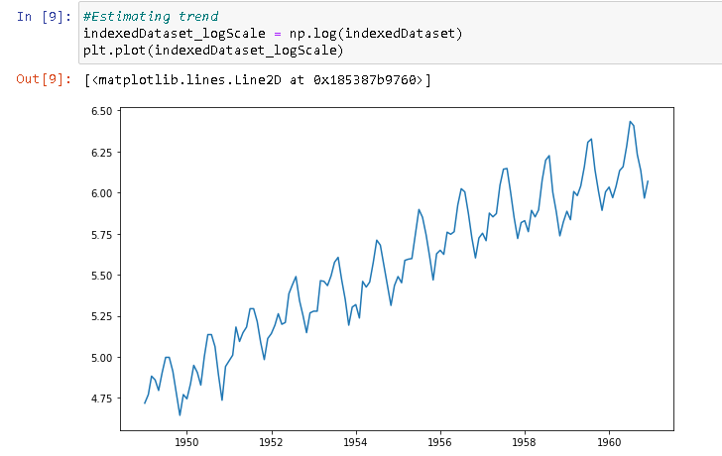
Feature engineering
Log scale transformation

Slide 9
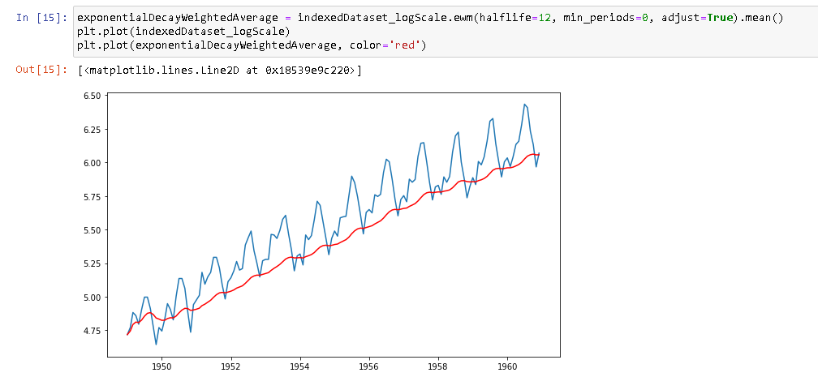
Feature engineering
Exponential decay transformation

Slide 10
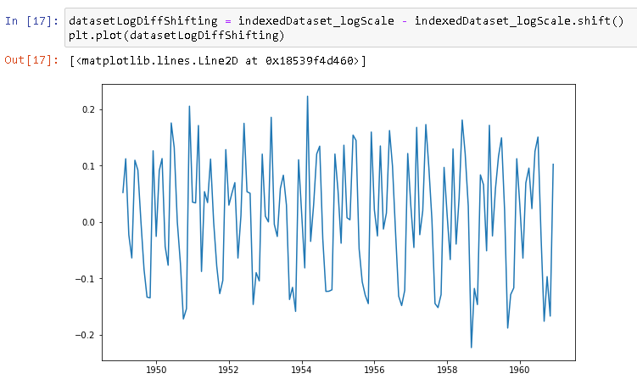
Feature engineering
Time shift transformation

Slide 11
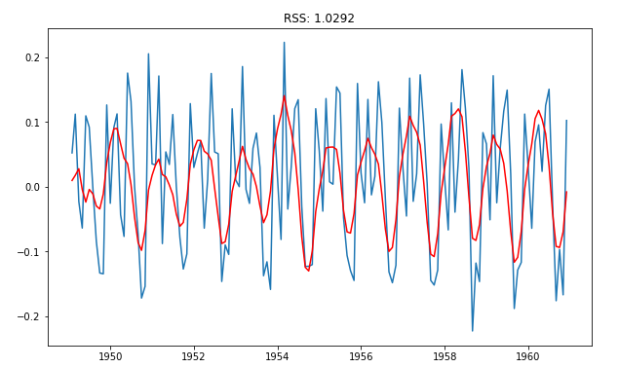
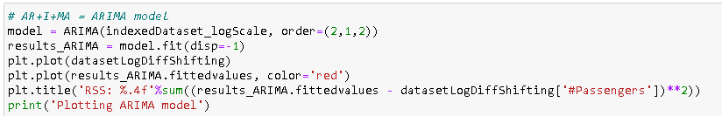
MODEL /TECHNIQUE USED:
ARIMA

Slide 12
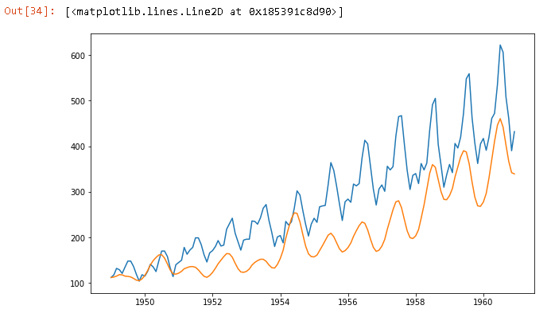
ARIMA PREDICTIONS

Slide 13
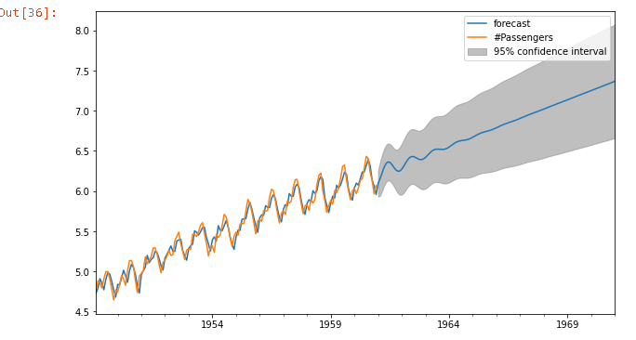
key findings
Predicted values are very close to real time series value,
which means the model accuracy is fair enough.

Slide 14
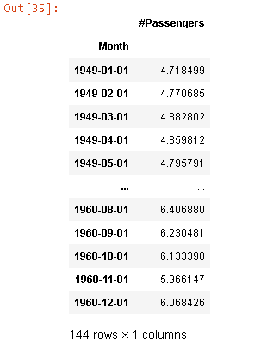
How helpful for business?
Able to predict 144 new datapoints, which means
Model can predict 12yrs future data(12x12)

Slide 15
Thank you…!!

